Slide 1

Project Presentation
Predictive Analysis Approch for House Price Prediction using Multiple Linear Regression.
By
Bhaskar Biswas

Slide 2

Data Science Lifecycle
Problem Statement
Data Mining
Data Cleaning
Data Exploration
Feature Engineering
Predictive Modeling

Slide 3
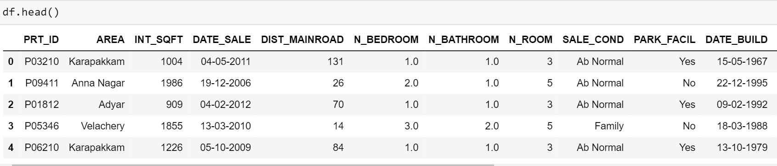
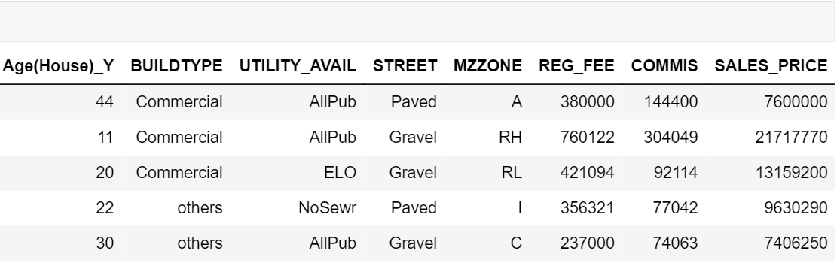
Problem Statement & Data Mining
Atributes:
PRT_ID = Id of house
AREA = In which area house is located in Chennai
INT_SQFT = Area in sqft
DATE_SALE = When house was sold
DIST_MAINROAD = Distance of house from main road
N_BEDROOM = Number of Bedrooms
N_BATHROOM = Number of Bathrooms
N_ROOM = Number of Rooms
SALE_COND = Sale condition
PARK_FACIL = Is parking available or not
DATE_BUILD = Date house was built
Age(House)_Y = Age of house
BUILDTYPE = Purpose of house
UTILITY_AVAIL = Facilities available there
STREET = How is street outside that house
MZZONE = Which zone it is in
REG_FEE = Registration fee after sales
COMMIS = Commission fee after sales
SALES_PRICE = Sale price of house
Real estate transactions are quite opaque sometimes and it may be difficult for a newbie to know the fair price of any given home. Such forecasting models will help buyers to identify a fair price for the home and also give insights to sellers as to how to build homes that fetch them more money.
This dataset is used to predict house price based on input like Area, number bedrooms, number of bathrooms, sales condition, parking facilities, street, Mzone, build type, registration fees.

Slide 4

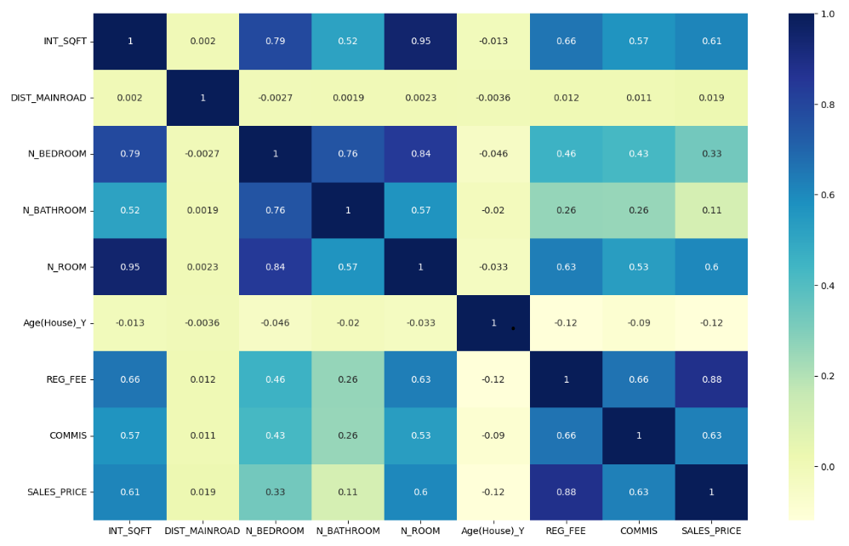
Problem Solution
Machine Learning Algorithms(MLR)
In this project, we attempt to bridge the gap by providing a systematic analysis of the various area's house records for the purpose of price prediction.

Slide 5
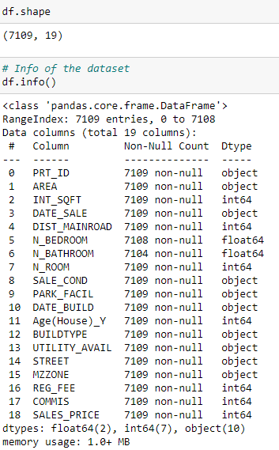
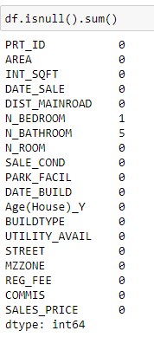
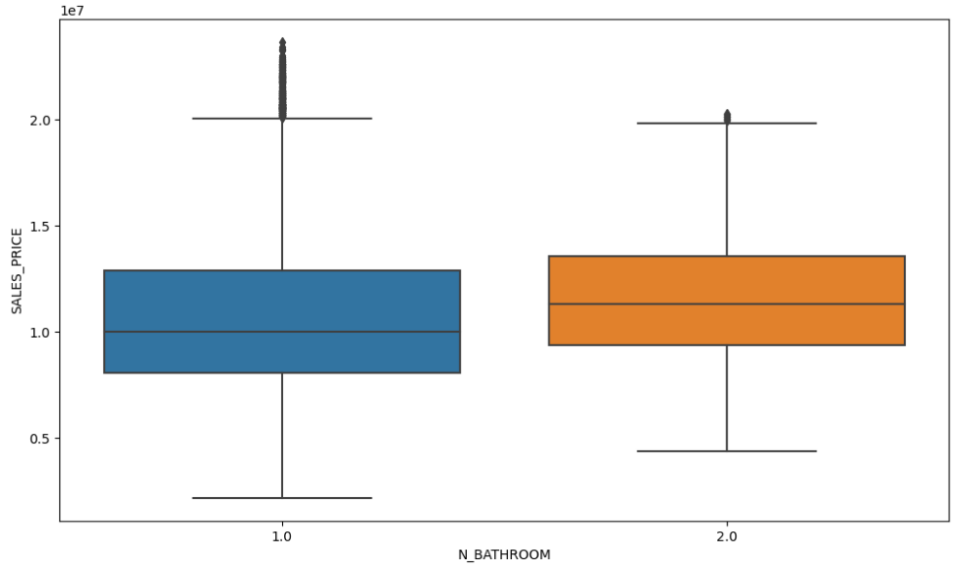
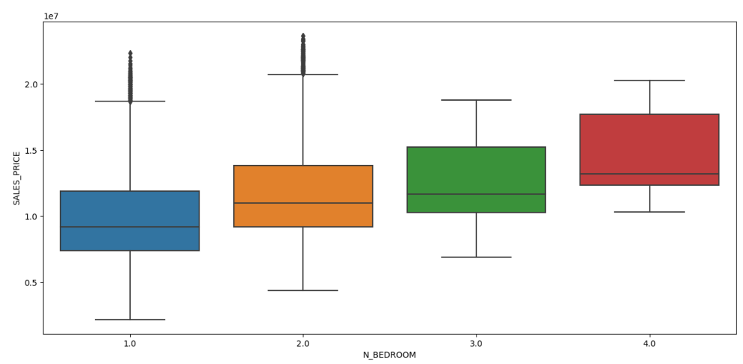
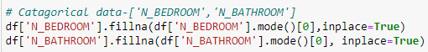
Data Cleaning

Slide 6

EDA Exploratory Data Analytics

Slide 7
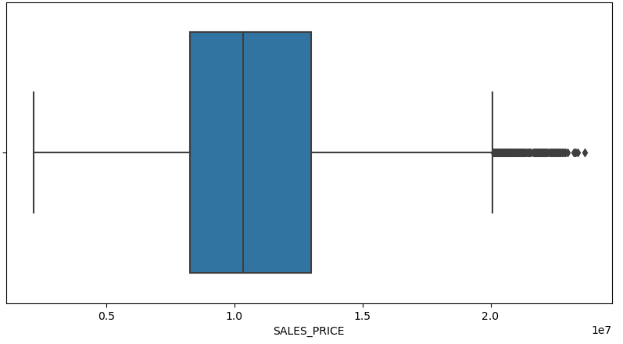
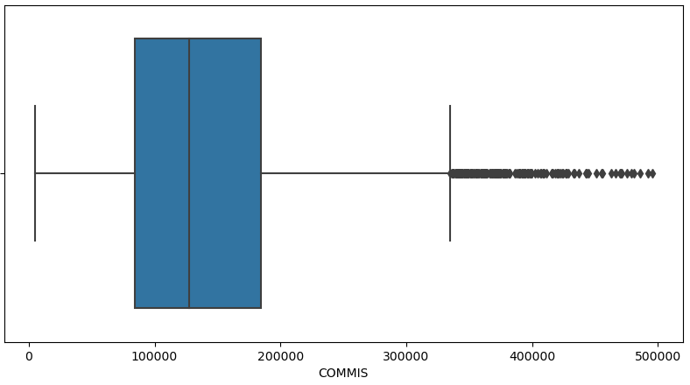
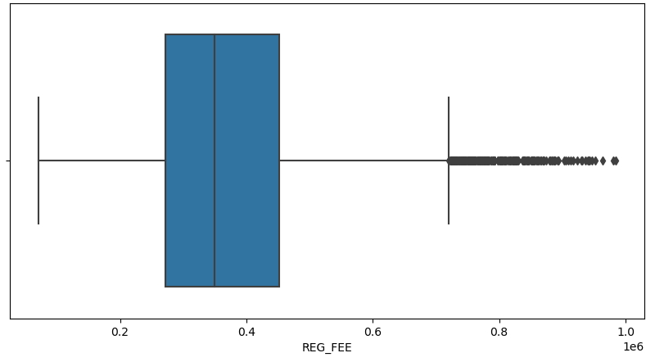
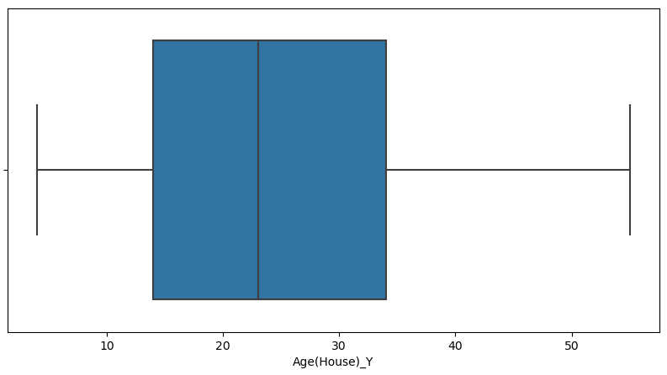
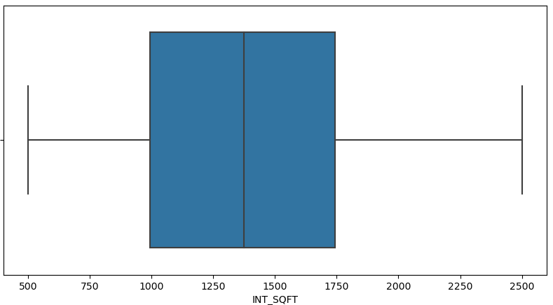
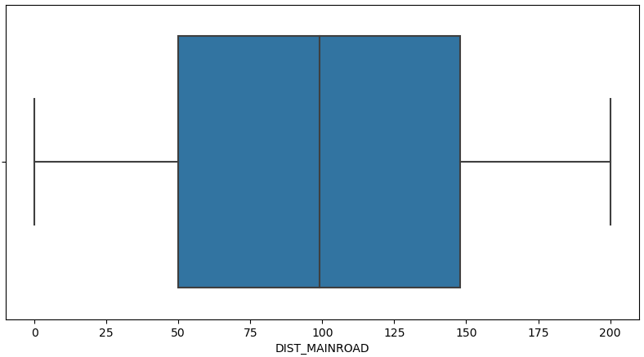
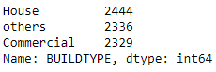
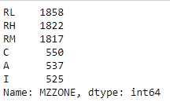
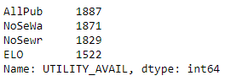
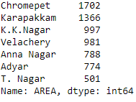
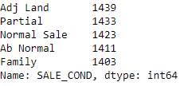
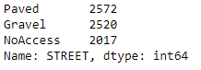
Continuous Variables
Categorical
Variable

Slide 8
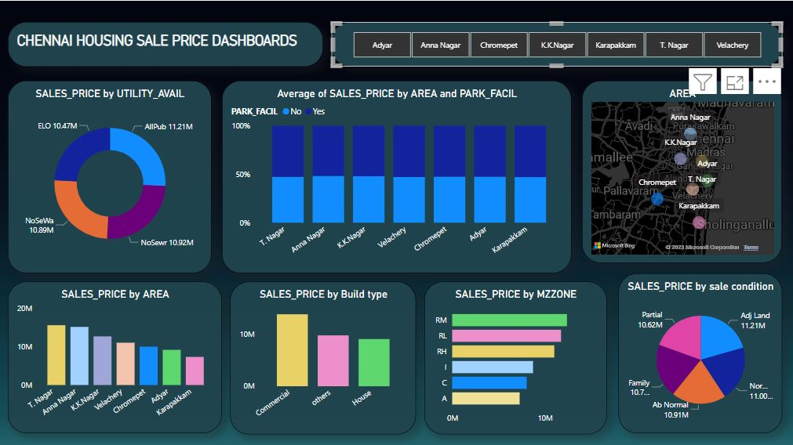
UTILITY_AVAIL
1.AllPub - All public Utilities (E,G,W,& S)
2.NoSewr - Electricity and Gas Only
3.NoSeWa - Electricity, gas And Water(Saptic tank)
4.ELO - Electricity only
Sale Condition
1.Adj Land - Adjoining Land Purchase
2.Normal Sale - normaly sale
3.Family - sale between family member
4. Ab Normal - Trsder, forecloser etc
5. Partial - Home was not completed when last assessed (associated with New Homes)
MZZONE
1.RL - Residential Low Density
2.RM - Residential Medium Density
3.RH - Residential High Density
4.I - Industrial
5.C - Commercial
6.A - Agriculture
HERE WE TRY TO A BETTER VISULISEATION AREA WISE USING POWER BI

Slide 9
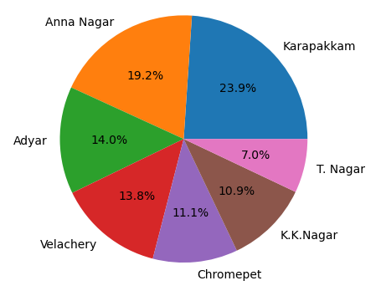
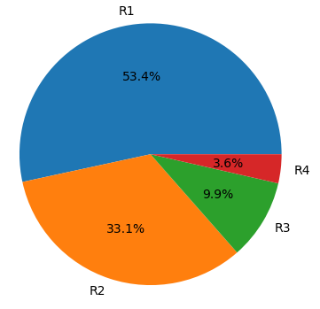
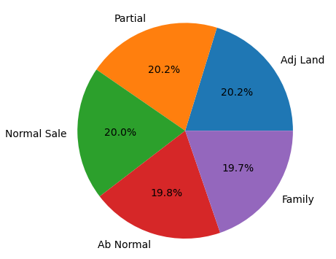
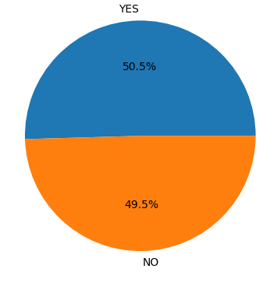
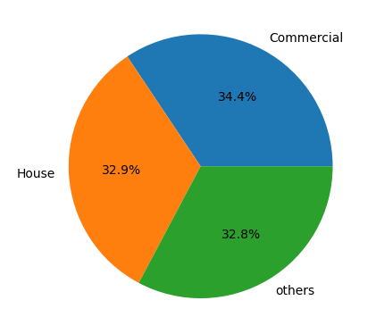
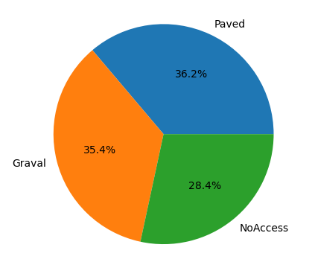
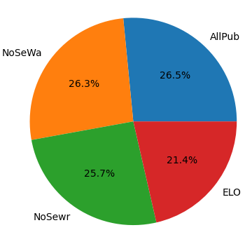
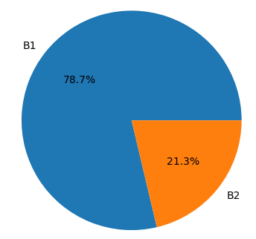
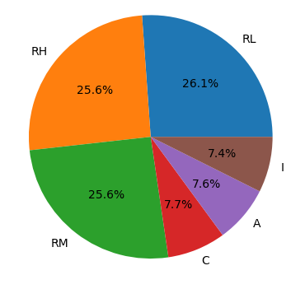
P
I
E
P
L
O
T

Slide 10
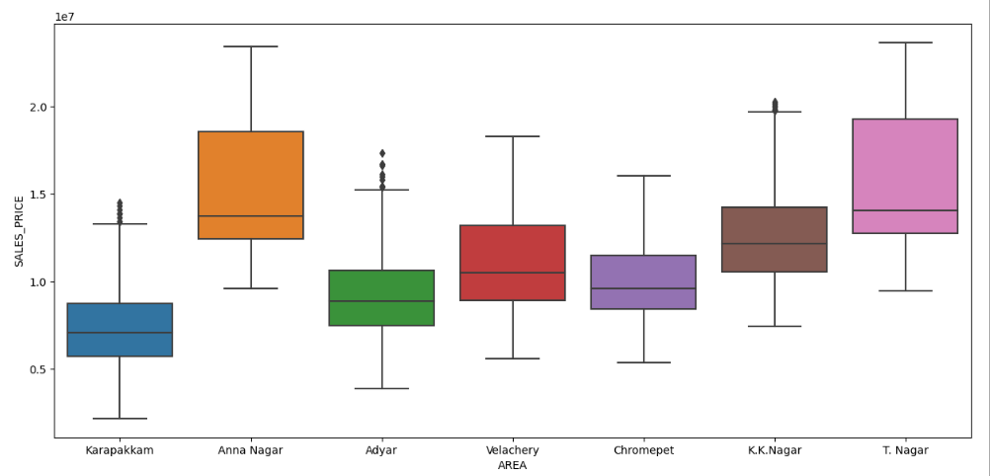
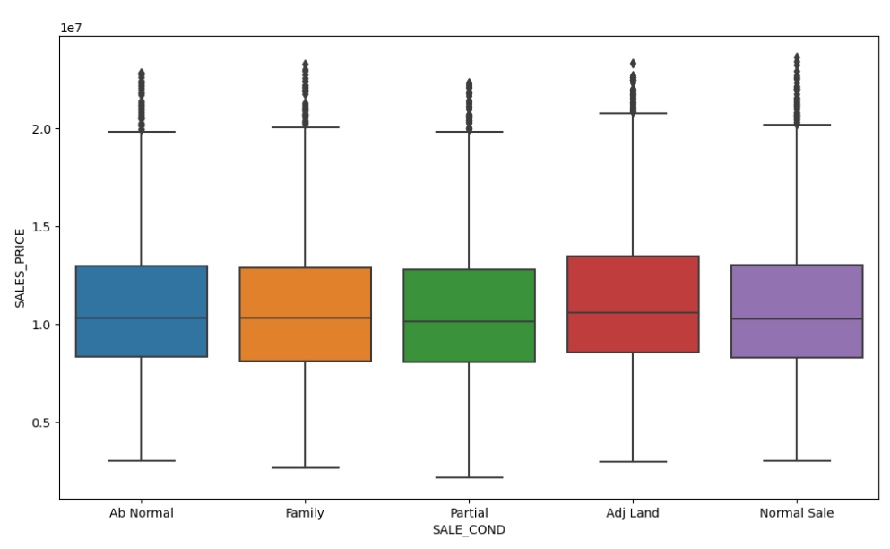
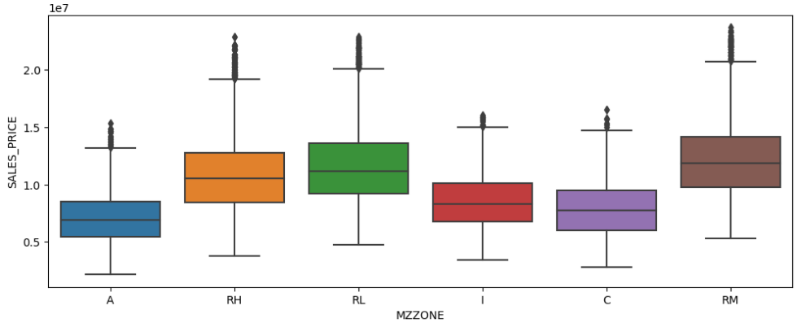
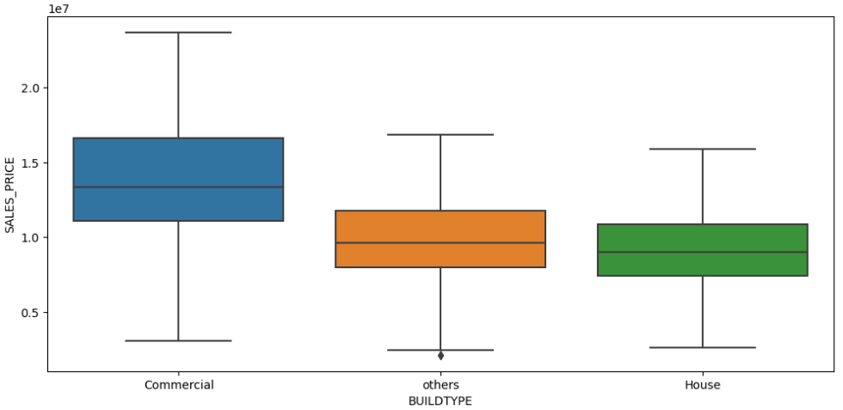
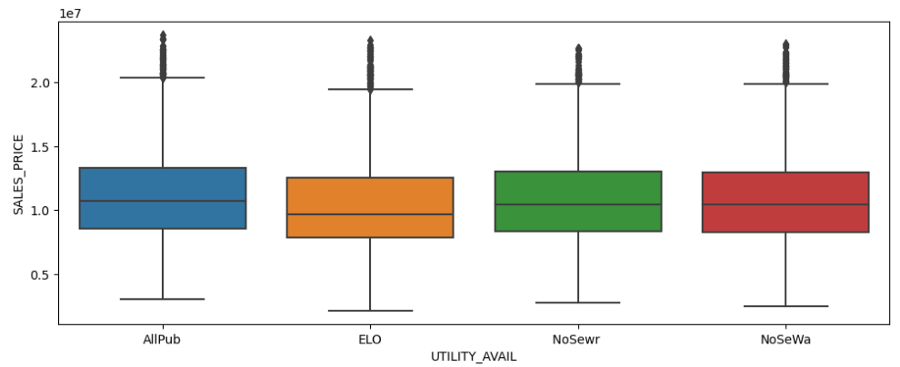
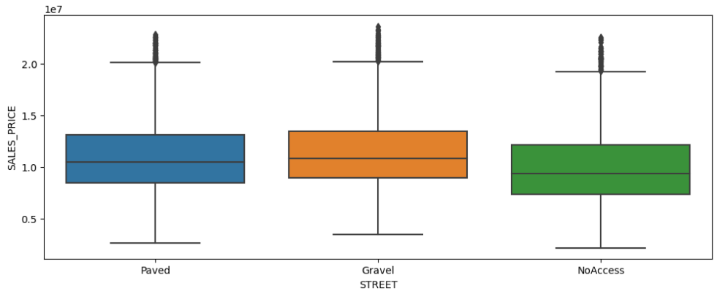
BOX PLOT
We see the house price is high in Anna Nagar and T.Nagar area.House which is located in low density(RL) the price is high.

Slide 11
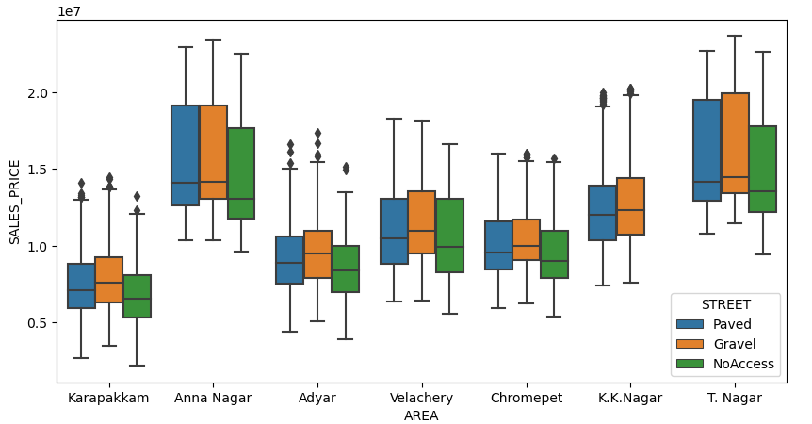
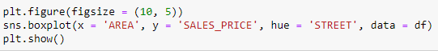
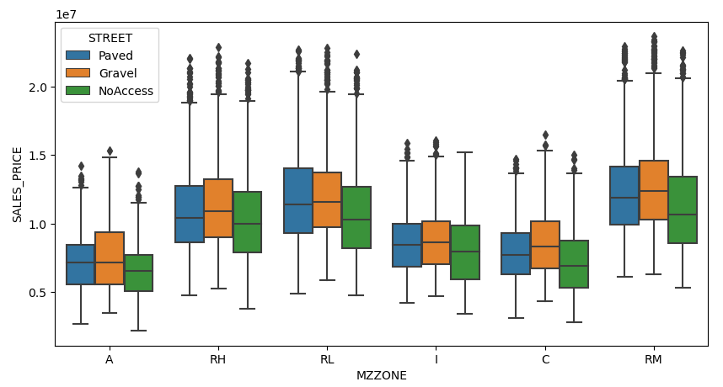
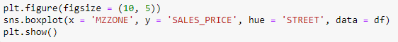
House price is high in Anna Nagar and T. Nagar where street type is Gravel.
In this box plot we see every type of MZZONE for Gravel street the price is high except RL(Residential Low Density).

Slide 12
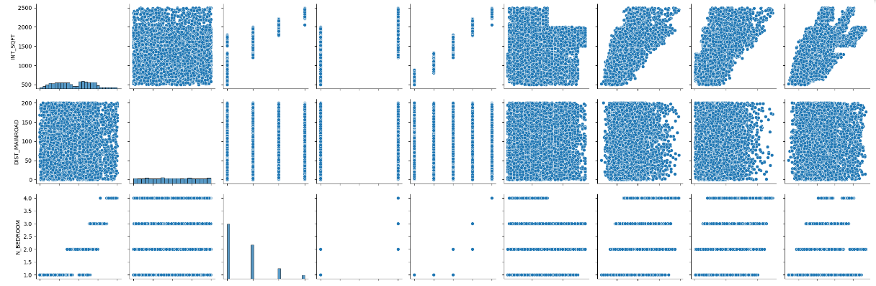
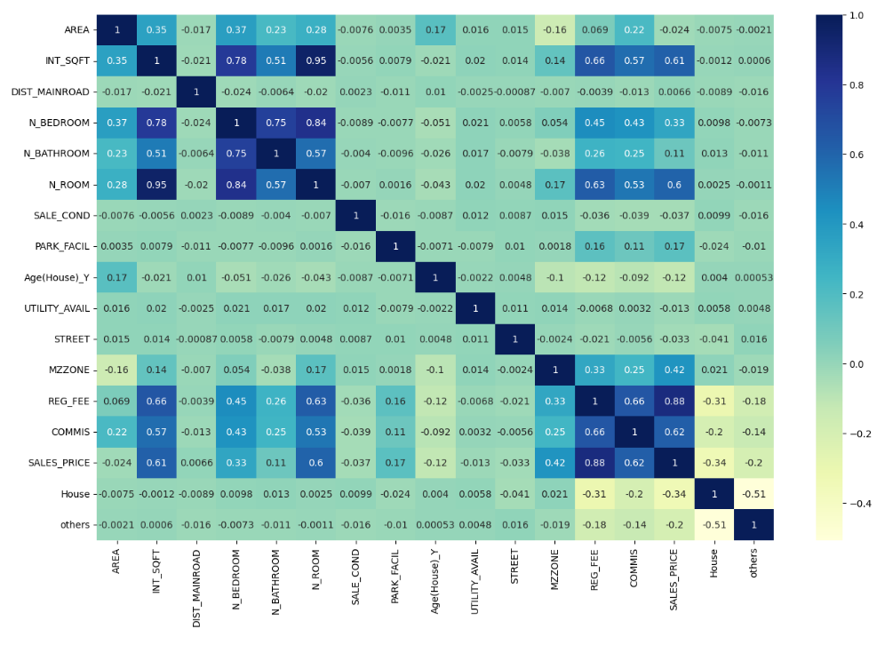
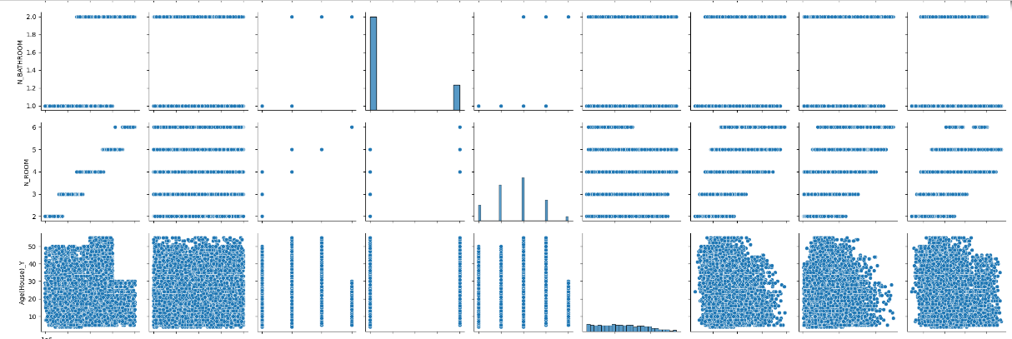
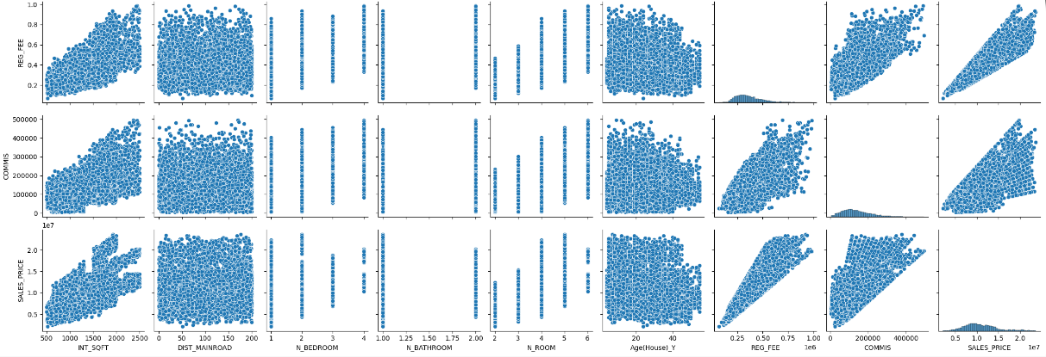
HEAT MAP
P
A
I
R
P
L
O
T

Slide 13
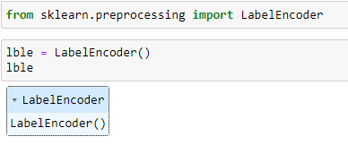
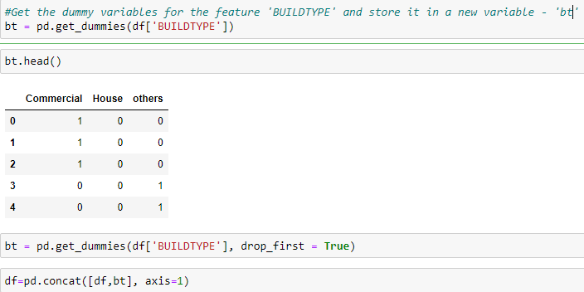
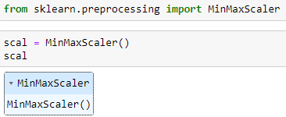
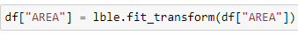
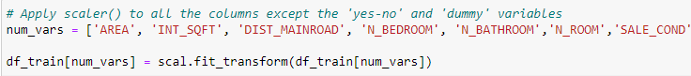
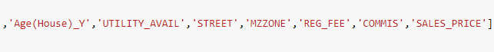


Feature Engineering
Label Encoding
Dummy Variables
Rescaling the Features

Slide 14

Machine Learning Models

Slide 15




Splitting the Data into Training and Testing Sets
We have two approach for linear Model building.
1.Consider all the variables in model building and keep on dropping one by one variable which is not statisticaly significant to our target variable.
2.Build a model using one variable which is statisticaly significant and keep on adding the variable one by one.
Building a linear model
Dividing into X and Y sets for the model building
We use statsmodels.api for model building.we drop some featers one by one considering p-values and VIF (valence inflation factor).
1.If p-value <0.05 and VIF <10 –we keep the variable
2.If p-value >0.05 and VIF>5 – We drop the variable.it is not important.
3.If p-value>0.05 and VIF <5 –eliminate the variable 1st
4.If p-value <0.05 and VIF >5 – keep the variable.based on adj r2 value we remove later
5.This is regression type model.we focouse only Adjusted r2 value.higher adj r2 value is good for our model

Slide 16





After fit our model we see p-value is high Dist_mainroad and Adj r2 value is 92%.we drop Dist_mainroad because it is not statistically significant for our model.

Slide 17




We fit our model again, after dropimg DIST_MAINROAD.we saw p-value is more 0.05 and vif value is more than 5.that meens commission is not statistically significant for our model.we can drop it.

Slide 18






Then we drop INT_SQFT and again we fit.after fit we see vif value is more high for no of rooms.that is not statisticaly significant for our model.
We drop the column Commision and see for all variables p- value is 0.00 but vif value is high for INT_SQFT.thats meens it is not important for our model

Slide 19






Again we drop Age column and see for utility avail column the p value is high that’s meens this column is not significant for us.
After no of room column drop the Age of house column’s p-value is high.thats means that is also not statistically significant for our model

Slide 20





Residual Analysis of the train data
Making Predictions Using the Final Model
Finally we see our p-value is <0.05 for all remaining variables and vif value is <10(some times vif value is considerable less than 10).and our r2 value is 0.83.

Slide 21


Model Evaluation
Price = -0.0388 * AREA + 0.1060 * N_BEDROOM - 0.0696 * N_BATHROOM – 0.0068*SALE_COND + 0.0178 * PARK_FACIL – 0.0108 * STREET + 0.1020 * MZZONE + 0.7620 * REG_FEE - 0.0825*HOUSE – 0.0690*OTHERS + 0.1452

Slide 22

THANK YOU

